Slide 1
Global Cuisine Recipe Project
Individual Project
Presentation by: Tawanda Siyamachira

Slide 2
Concept of project
The concept of this project came from my love for food.
The project sets out to allow users to collate recipes with respect to various food qualities.
The project sets out to make an application that allows users retrieve and upload recipes;
with functions that allow to categories foods by food groups.
with functions that allow to categories foods by nutritional values.
with functions that allow to categories foods by caloric values.
with functions that allow for users to be able to populate a recipe by using the ingredients in database.

Slide 3
Scope
This project aims to create a full-stack web application following the Enterprise Architecture Model, using;
an application back-end developed using Java.
a managed database hosted within. MySQL in GCP.
a front-end developed using JavaScript, HTML, CSS.
This is to be achieved by utilising methodologies that have been covered in previous modules such as planning the project using the design techniques (Kanban Boards). Utilise a CI Pipeline in order to automate the building and deployment of my artifact (Jankins, Sonarqube & Nexus). The project is to be tested using JUnit, Integration and Selenium testing methods.

Slide 4
Specification
The project is to be achieved by the implementation of the following concepts;
Agile & Project Management - a Kanban board with user stories and tasks needed to complete the project.
Databases - a relational database will be used to store data persistently for the project, with at least 2 tables that exhibit functionality relationships.
Back-end Programming Fundamentals - a functional application that adheres to best practices and design principles, composed in Java language and meets the requirements set on your Kanban Board.
Front-end Programming Fundamentals - a functional application that adheres to best practices and design principles, composed in JavaScript, HTML, CSS. This is to also meets the requirements set on your Kanban Board.
Automated Testing - unit tests and integration tests are used to validate application.
Selenium Testing - unit tests and integration tests are used to validate application.
Continuous Integration - use of Version Control System to fully integrate the code into a CI server and deployed to an artifact repository manager.

Slide 5
Consultant Journey
During the course of this project, the implementation of various methodologies and technologie were practically implemented:
Setting-up and manipulating database systems respective to the project specification.
Implementing Many-to-Many relationship between entities.
Converting from H2 database to Cloud-based database system.
Integration between the database and front-end; HttpRequests, Buttons, Tables, etc..
Manipulating CSS files to suit styling.
An understanding of the importance of manual, automated and selenium testing.
Reviewing and Addressing Issues, Code Smells and Security Hotspots.
Effective use of a version control system in order to keep the project backed up and accessible to all parties and technologies that utilise the repositories.
Managing and tracking the project by the use of Agile Project Management methodologies, as this is essential in order to address the product specification and milestones.
WHAT I HAVE LEARNED.

Slide 6
Consultant Journey
Database: GCP MySQL server
Back-end Programming language: Java
API Development Platform: Spring
Front-End Web Technologies: HTML, CSS, JavaScript
Build Tool: Maven
Unit Testing: JUnit / TestNG , Mockito
Integration Testing: Selenium
Test Reporting: Surefire / ExtentReports
Version Control system: Git
Host of version control system repository: GitHub
CI Server: Jenkins
Cloud server: GCP virtual machine aided by Sonarqube.
Artifact Repository Manager: Nexus
WHAT TECHNOLOGIES/CONCEPTS WERE IMPLEMENTED.

Slide 7
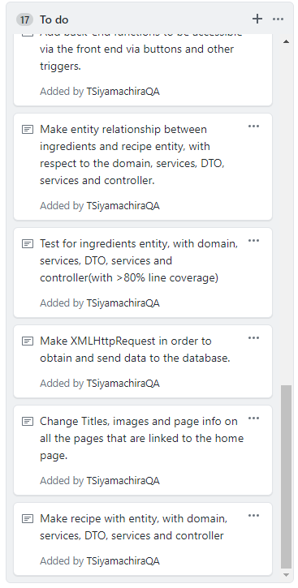
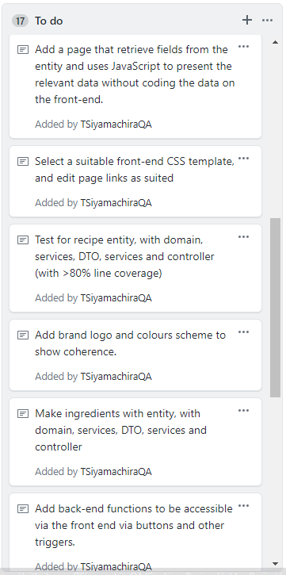
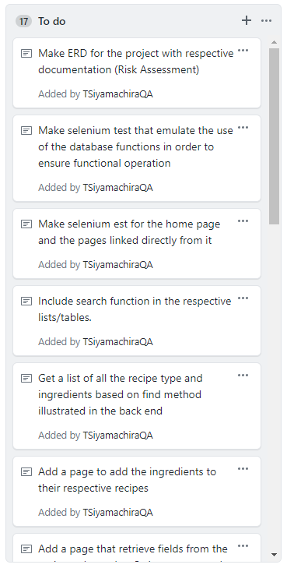
Initial Plans (Initial Kanban Board)
In the initial phase of the project a Kanban Board was composed in order to address the project specification as user-stories that can be approached as individual tasks.
The user-stories were constantly updated as there were several emergent tasks due to the nature of the project.

Slide 8
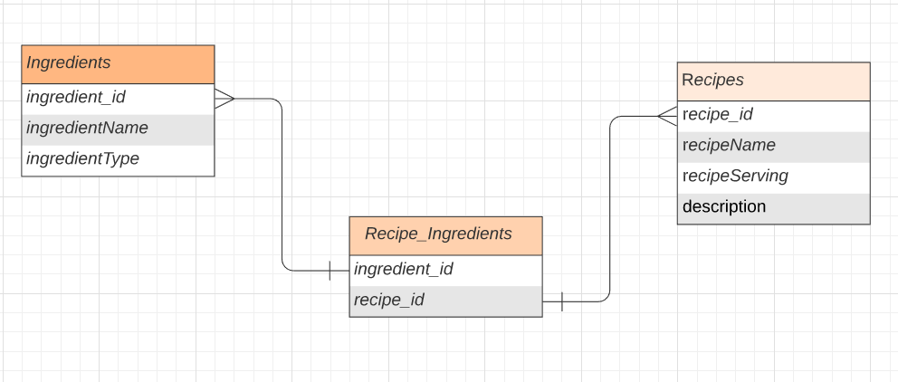
Entity Relationship Diagram (ERD)

Slide 9
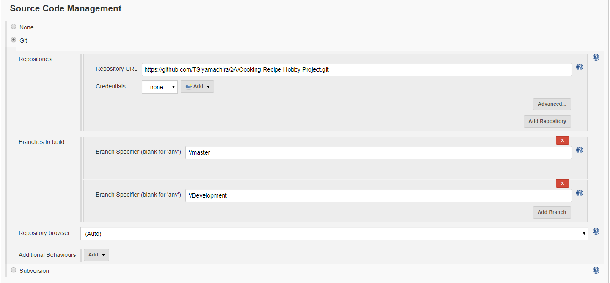
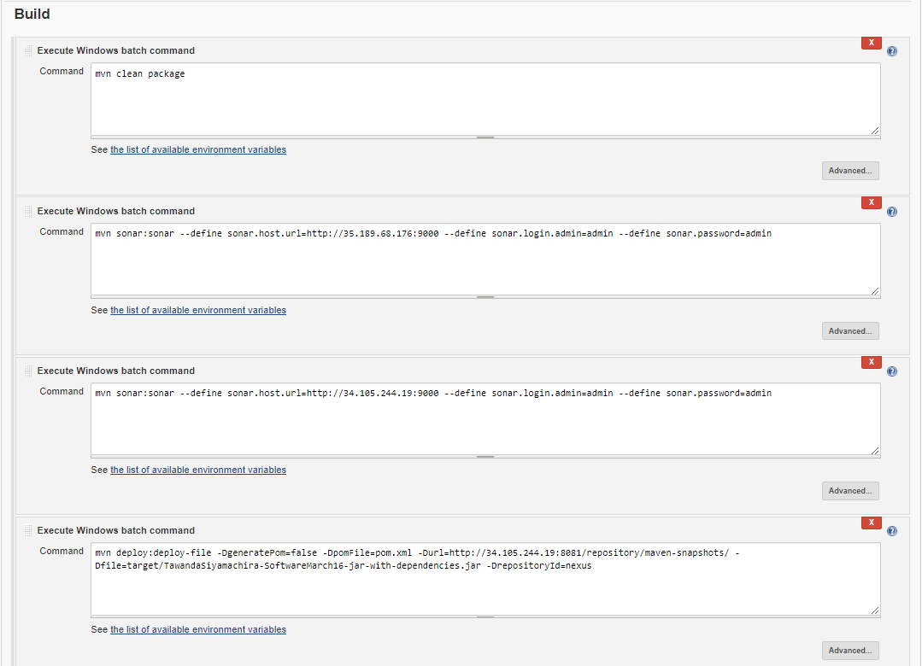
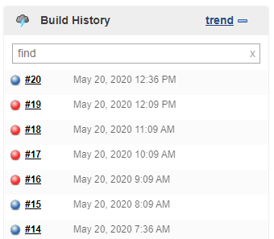
Continuous Integration (C.I Pipeline)

Slide 10
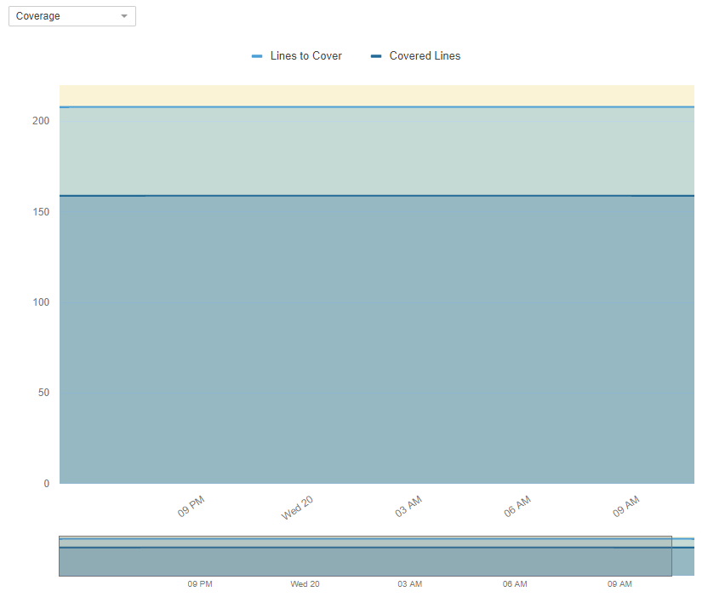
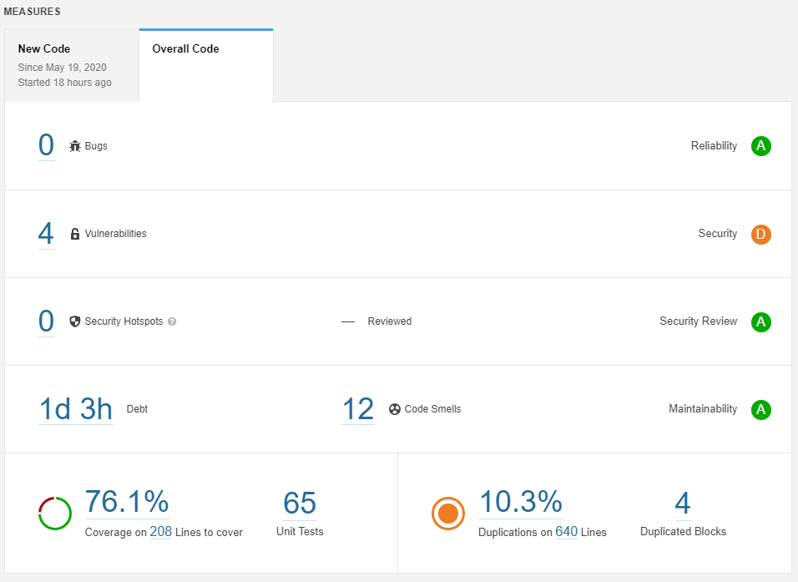
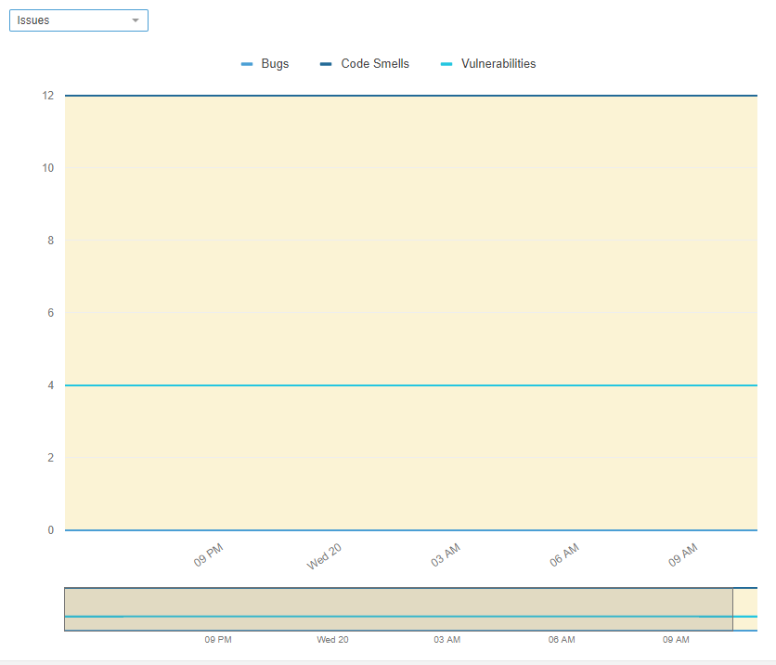
Sonarqube

Slide 11
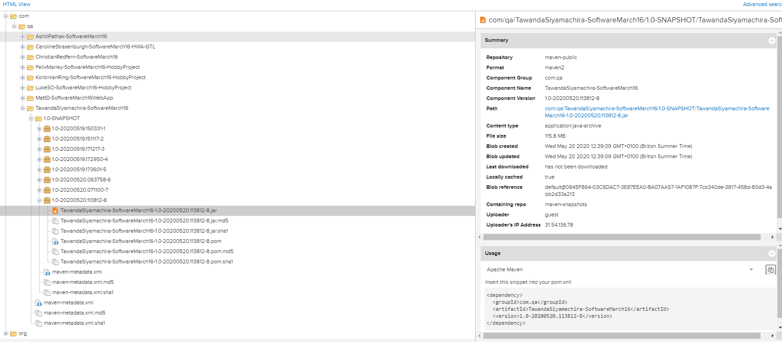
Nexus (Fat.jar)

Slide 12
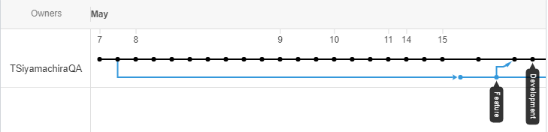
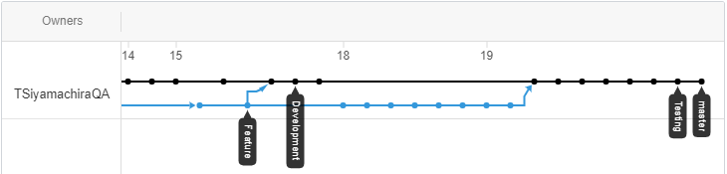
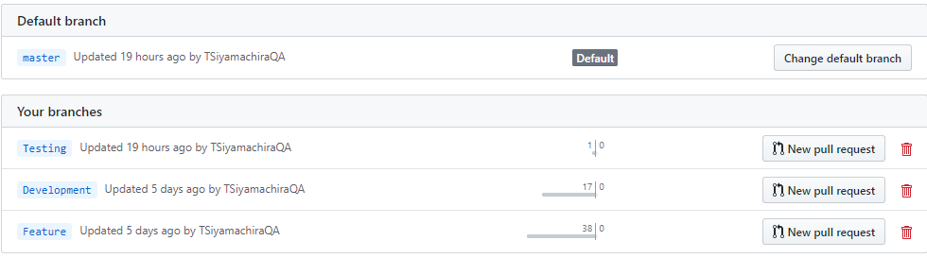
Agile Branching Strategy
The Master branch is the functional version of the application.
The Development branch is used to keep track of the functional feature-branch merges.
The Feature branch model was implemented throughout the whole project in order to add features to the code.
The Testing branch was used in order to commit any of the test classes of this application.
This model was also used to preserve the integrity of the master branch, for version control.

Slide 13
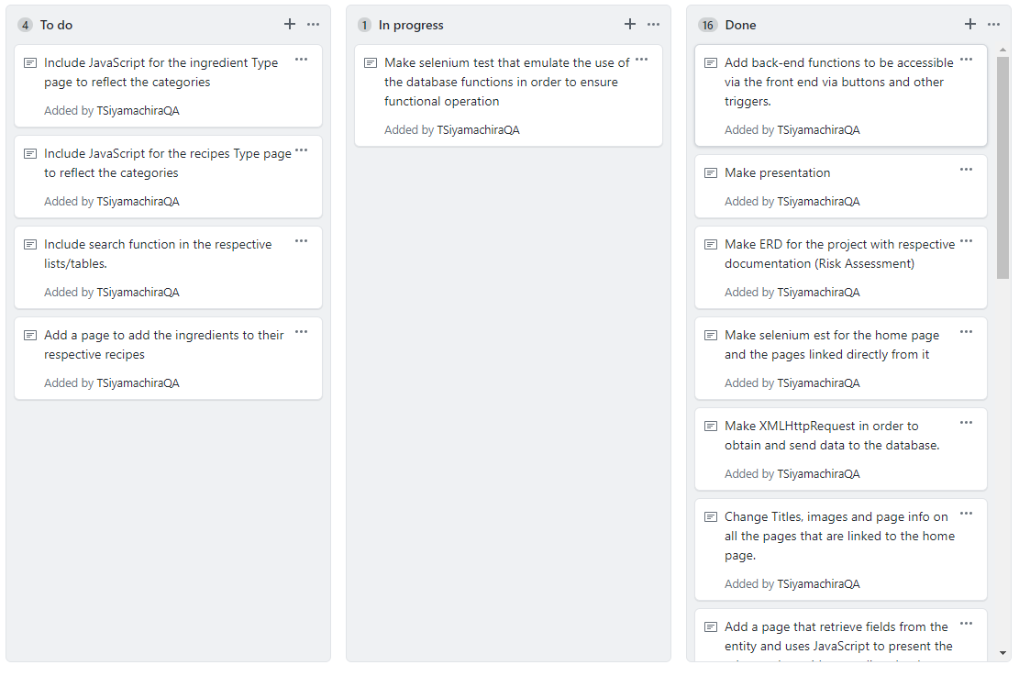
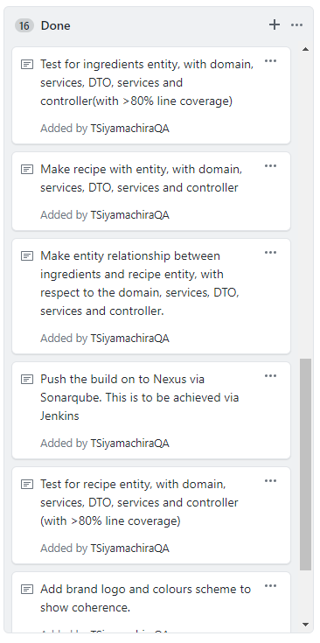
Sprint Review (Final Kanban Board)

Slide 14
Sprint Review
WHAT WENT WELL
Made a fully functional back-end that attends to all the database needs of the application.
Implementing XMLHttpRequests in the front end of the application successfully.
Making a user friendly front-end with the basic functions of the app reflected according. This also allows for further development and integration.
Running and composing Selenium tests for the front end in order to verify usability.
WHAT CAN IMPROVE/MOVING FORWARD
Implementation of more fields in my database entities.
Integration of “add ingredients to recipe” to the recipes page, allowing execution at the front-end.
Allowing to navigate and view each recipe/ingredient in a page that execute JavaScript to attain the relevant fields via XMLHttpRequests.
Add search function to each of the respective tables.
RETROSPECTIVE/CONCLUSION

Slide 15
QUESTION TIME
Any Questions?

Slide 16
Application Demo

